Slide 1
jQuery
About

Slide 2
What is jQuery
free, open source javaScript library
tested for cross-browser compatibility
gives you access to the DOM quicker than the onLoad event

Slide 3
JavaScript Libraries
Code library
Collection of pre-written code, classes, procedures, scripts
Makes JavaScript simpler to use
Not intended to extend the overall capabilities of JavaScript, but they do provide the tools to make JavaScript much easier to implement

Slide 4
Why use a code library?
Speeds up Overall development time
Using a library helps you write complex JavaScript effects quickly, and they will work in all browsers
Provides Standardization
If all developers in a shop use the same library, then everyone’s coding is consistent.
Code is more easily maintained
Tasks of updating and changing code are easier and faster

Slide 5
Why use a code library?
Libraries require a shorter learning curve than JavaScript
Often you will want to produce an effect that requires many lines of code, plus hours of troubleshooting and browser compatibility checks. Such code can be written in a matter of moments with the help of a library
Libraries are plentiful and widely available
Hundreds of library plug-ins have been created for developers to download and use

Slide 6
Disadvantages to Libraries
It can foster ignorant use of the language
The ability to use libraries to copy and paste JavaScript code encourages some developers with limited knowledge or skills to create scripts that they do not fully understand how to use.
This leads to more faulty, sloppy and error-ridden code on the Web, which in turn may be copied by others and proliferated
“My brother’s best friend’s nephew can build me a website!”

Slide 7
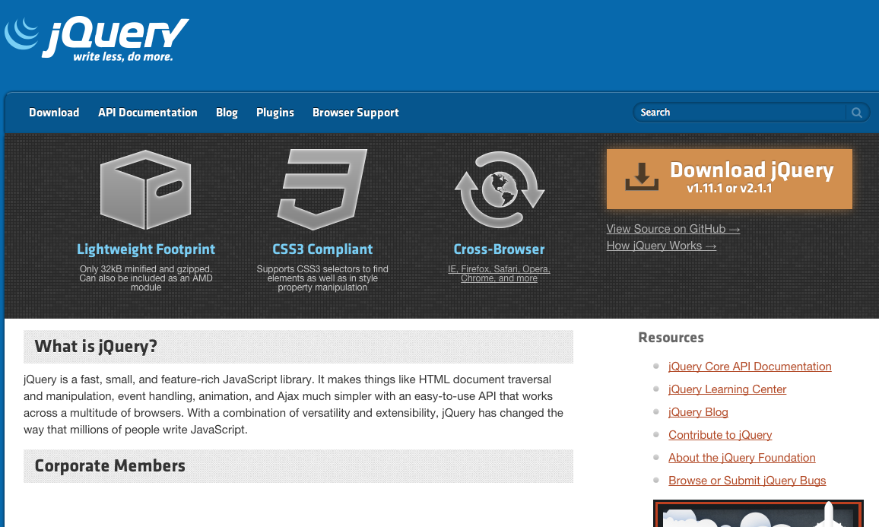
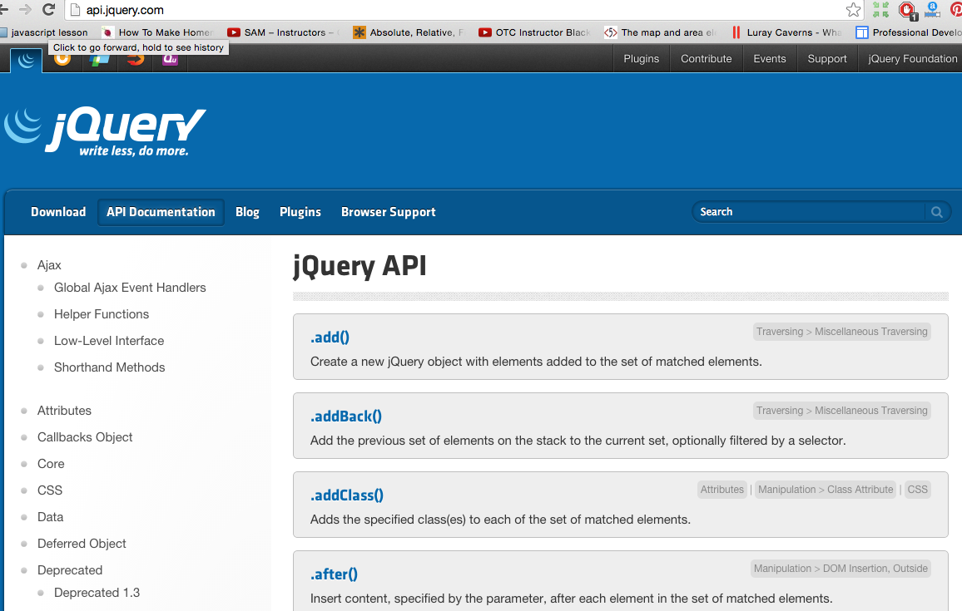
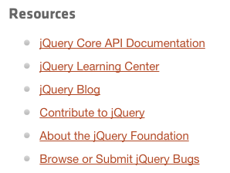
jquery.com
jquery.com
api.jquery.com

Slide 8
Two Ways to Include jQuery in your HTML
Download the library files
Download the jquery.js library file jquery.js
compressed -> saves bandwidth and improves performance in production
uncompressed -> best during development or debugging
<script src=“jquery-1.11.1.min.js”></script>
<script src=“jquery-1.11.1.js”></script>
Keep the file in the directory with your html or cssfiles
<script src=“jquery.js”></script>

Slide 9
Two Ways to Include jQuery in your HTML
Link to a Content Delivery Network (CDN)
CDN – a web server that hosts open-source software
Google CDN
Microsoft CDN
Advantage – don’t have to download the file
Disadvantage – you need internet connection to test
https://developers.google.com/speed/libraries/devguide#jquery
http://www.asp.net/ajax/cdn
<script src="//ajax.googleapis.com/ajax/libs/jquery/2.1.1/jquery.min.js"></script>

Slide 10
Accessing the jQuery Library
jquery()
or the shortcut version
$( )

Slide 11
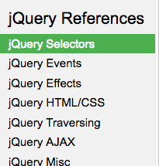
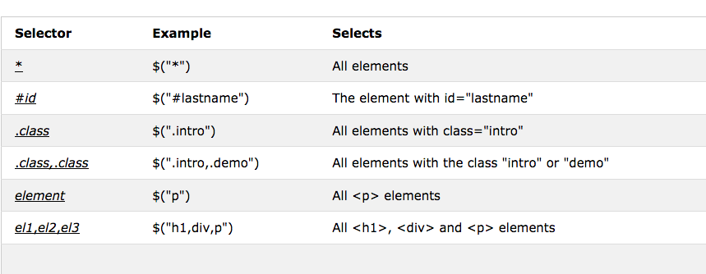
jQuery Selectors

Slide 12
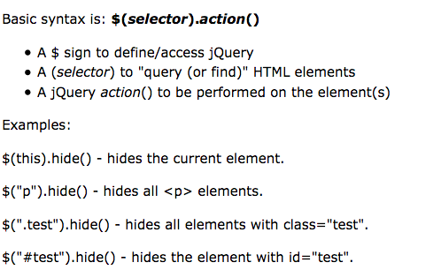


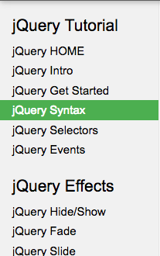
jQuery syntax

Slide 13
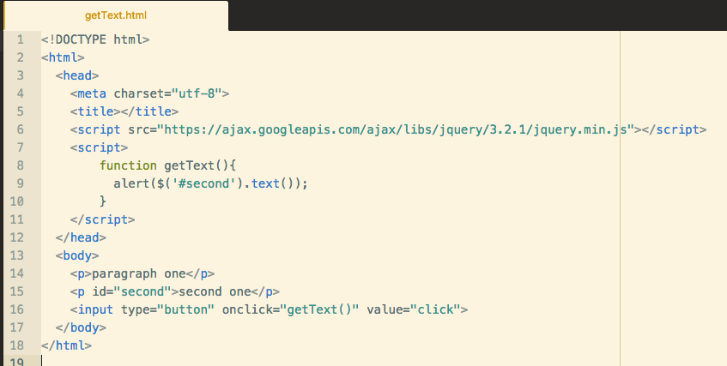
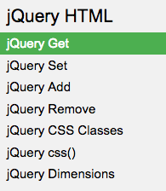
jQuery References

Slide 14
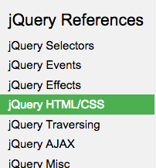
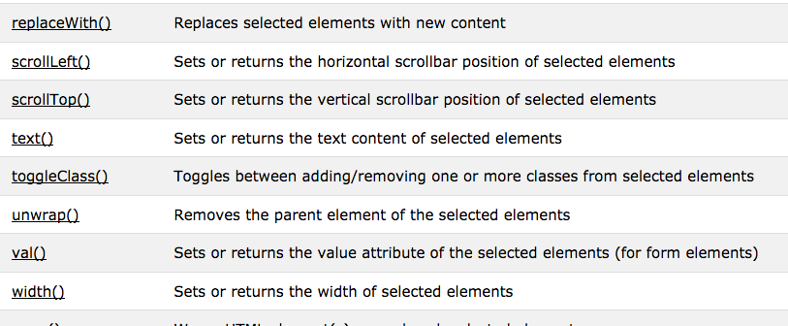
jQuery References

Slide 15
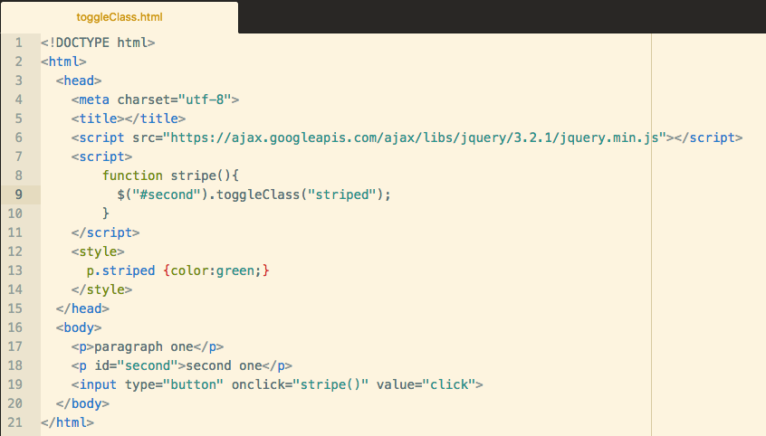

Slide 16
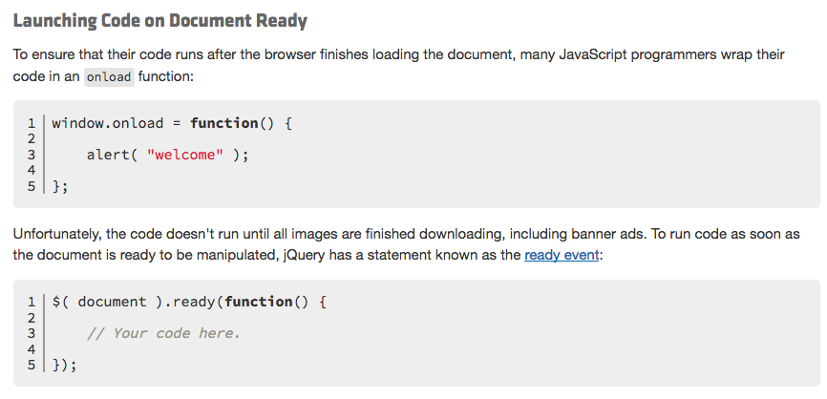
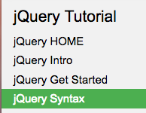
Document Ready Event
$(function() {
});
also written

Slide 17
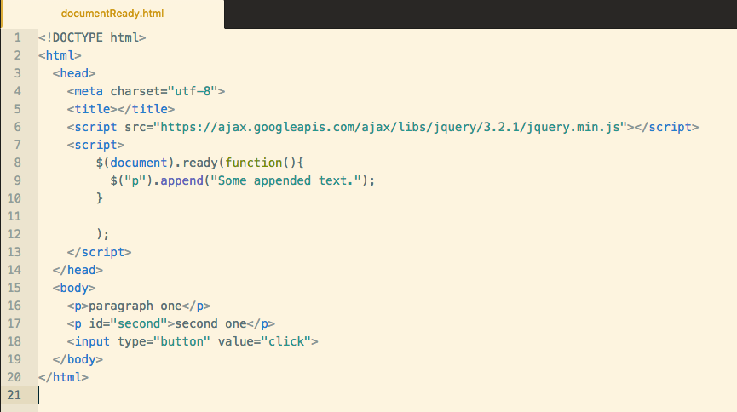
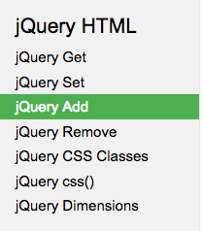

Slide 18
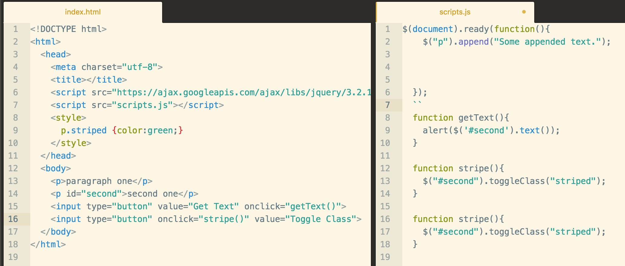
Putting it All Together

